Slide 1
FOLD HERE
FOLD HERE

Slide 2
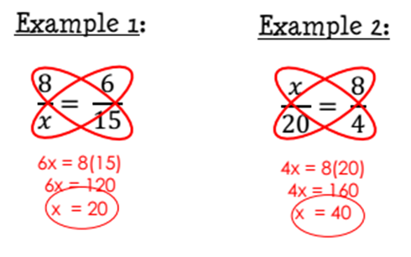
Solving Proportions Tab
Review:
**CROSS MULTIPLY**

Slide 3
Writing Proportions Tab:

Slide 4
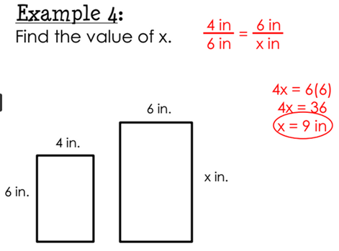
Similar Figures Tab:

Slide 5
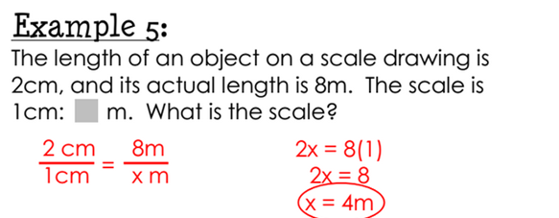
Scale Drawings Tab:

Slide 6
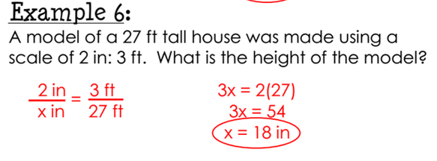
Scale Drawings Tab

Slide 7
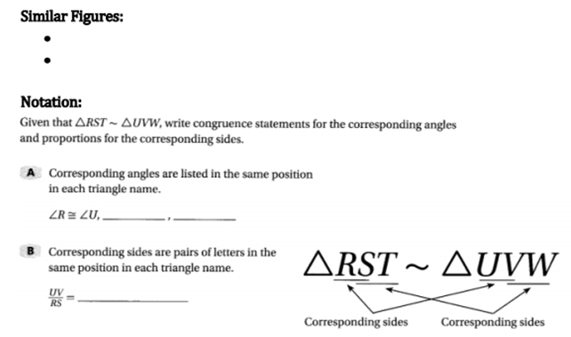
Guided Notes
Corresponding angles are congruent
Corresponding sides are proportional

